Slide 1
Missing Data

Slide 2

What is the problem?
FoS: Medical Affairs training

Slide 3

Why do we need to do something about it?
Data
Inferences
The inferences about our medicines comes from our data
Missing data may seriously compromise our inferences by introducing bias, especially if missing data are not handled appropriately.
  Loss of power, inefficiencies and potentially false positive findings (Type I Error).
  Inaccurate conclusions for the investigative treatment.
FoS: Medical Affairs training

Slide 4
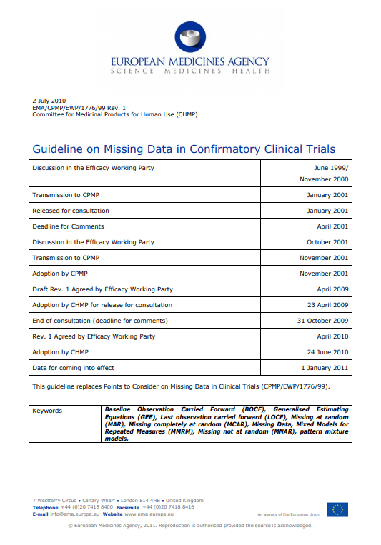
Can we not just ignore the missing data?
Not necessarily.
Basing analyses on only the data that is available (complete cases) this makes strong assumptions about the reasons why data are missing.
  This may not be appropriate.
Regulators are particularly hot on this topic
  Impact of missing data and methods used to account for it
  Sensitivity around the missing data
  May question the reliability of the estimate
FoS: Medical Affairs training

Slide 5
Motivating example
Graph of response and non-response rates by treatment group
Missing data was imputed using non-responder imputation.
A conservative, but not uncommon approach to dealing with binary data.
FoS: Medical Affairs training

Slide 6
Types of Missing Data
Missing Completely at Random (MCAR)
Missing Not at Random (MNAR)
Missing at Random (MAR)
FoS: Medical Affairs training

Slide 7





Types of Missing Data
Homework grades example - MCAR
The school dog eats the students homework at random
Missing Completely at Random (MCAR)
  Failure to observe a value does not depend on any data (observed or missing) – it is random
  Clinical Trial Examples: lost data, equipment failure, personnel error, subject moving away
FoS: Medical Affairs training

Slide 8
Types of Missing Data
Homework grades example - MAR
The school dog eats the homework closer to him
Missing at Random (MAR)
  Failure to observe a value is dependent on observed data (the student’s location) but does not depend on the data that are unobserved (the homework grade)
  Clinical Trial example: younger subjects being worse at completing eDiary.
FoS: Medical Affairs training

Slide 9

Types of Missing Data
Homework grades example - MNAR
The school dog eats the homework achieving the top grade
Missing Not at Random (MNAR)
  Failure to observe a value depends on the value that would have been observed (the homework grade).
  Clinical Trial example: longitudinal data where missingness may be related to study dropout
FoS: Medical Affairs training

Slide 10

Knowledge Check
CHATBOX
Missing visit due to COVID-19 isolation period in unvaccinated subject
MCAR
A
Missing dosing data due to iPad breaking
MAR
B
Missing primary endpoint as subject dropped out due to lack of efficacy
MNAR
C
FoS: Medical Affairs training

Slide 11
Knowledge Check
CHATBOX
Missing visit due to COVID-19 isolation period in unvaccinated subject
MCAR
A
Missing dosing data due to iPad breaking
MAR
B
Missing primary endpoint as subject dropped out due to lack of efficacy
MNAR
C
FoS: Medical Affairs training

Slide 12
Methods for Handling Missing Data
  Not an exhaustive list, but here are some common examples…
Non-Responder Imputation (NRI)
May under- or over-estimate efficacy depending on a number of factors, including differential withdrawal from any treatment arm
Last Observation Carried Forward (LOCF)
Can over-estimate efficacy and/or under-estimate safety where the subject’s condition is expected to deteriorate over time
Mixed Models Repeated Measures (MMRM)
Used with longitudinal continuous data,
does not involve any formal imputation
implicitly assumes MAR
Multiple Imputation (MI)
Simulation based technique implicitly assumes MAR. Imputations can be performed under different assumptions, e.g Jump to Reference
FoS: Medical Affairs training

Slide 13
Tipping Point Analysis
“Stress Testing” the Missing Data Handling
What? A type of sensitivity analysis
Why? Aims to identify which assumptions about the missing data lead to a change in the conclusion
How? Repeat analysis for a range of missing data scenarios, each time recording what the conclusion
Conclusion
The more extreme our assumptions need to be in order to “tip” the conclusion of the analysis, the greater the robustness of the original analysis.
FoS: Medical Affairs training

Slide 14
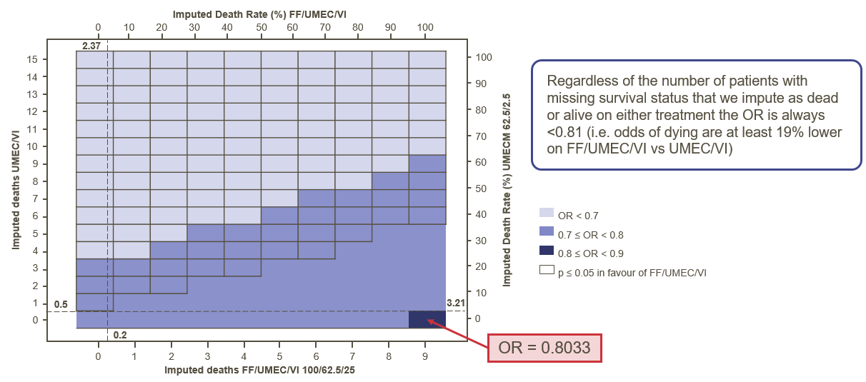
Tipping Point Analysis Example: IMPACT
Logistic Regression (testing assumptions around missing data)
15 on UMEC/VI arm and 9 on FF/UMEC/VI arm had missing data
Figure shows the OR for all possible combinations of assuming these people are dead or alive
Statistically significant results have a border
Regardless of the number of patients with missing survival status that we impute as either dead or alive on either treatment arm the OR is always less than 0.81. i.e. the odds of dying is at least 19% lower on Trelegy vs Anoro.
FoS: Medical Affairs training

Slide 15
A piece of the puzzle: Linking to Estimands
How we handle our missing data caused by events occurring after treatment has start feeds into a bigger concept known as an Estimand.
Estimands
Add transparency around how we are assessing our trial objectives.
Require teams to explicitly state how they are handling of the data impacted by intercurrent events.
Aid comparisons making against our competitors
What question are we interested in?
Target Patient Population
Endpoint of Interest
Treatment
Summary Measure
Strategy for Intercurrent Events
Resources:
FoS Webinar of Estimands
GSK White paper on estimands 25 Oct 2018.pdf (gsk.com)
Estimand Framework (R1 Addendum to ICH E9)
FoS: Medical Affairs training

Slide 16
Estimand example: INTREPID STUDY
 | Primary Estimand
Population | ITT
Treatment | FF/UMEC/VI vs Non-Ellipta MITT
Endpoint | CAT response status
Summary measure | Odds Ratio
Intercurrent events | Discontinued randomised treatment. Modified randomised treatment regime. Changed pulmonary rehab status. Started oxygen therapy For a data was used if available. For b, c and d the patient was set as a non-responder. Missing data was imputed using multiple imputation assuming a MAR assumption.
 | Primary Estimand | Supportive Estimand
Population | ITT | ITT
Treatment | FF/UMEC/VI vs Non-Ellipta MITT | FF/UMEC/VI vs Non-Ellipta MITT
Endpoint | CAT response status | CAT response status
Summary measure | Odds Ratio | Odds Ratio
Intercurrent events | Discontinued randomised treatment. Modified randomised treatment regime. Changed pulmonary rehab status. Started oxygen therapy For a data was used if available. For b, c and d the patient was set as a non-responder. Missing data was imputed using multiple imputation assuming a MAR assumption. | Discontinued randomised treatment. Modified randomised treatment regime Changed pulmonary rehab status. Started oxygen therapy, their CAT data was used if available. Premature discontinuation from the study (resulting in missing data). For a, b, c and d data was used if available. For e the patient data was missing due to no further collection of data when withdrawing from the study. Missing data were considered as non-responders.

Slide 17
Estimand example: INTREPID STUDY
Primary Effectiveness Endpoint (ITT Population)
 | Primary Estimand |  | Supportive Estimand
 | FF/UMEC/VI (N=1545) | Non-Ellipta MITT (N=1547) | FF/UMEC/VI (N=1545) | Non-Ellipta MITT (N=1547)
n | 1539 | 1543 | 1539 | 1543
Responder | 731 (47%) | 616 (40%) | 847 (55%) | 683 (44%)
Non-responder | 756 (49%) | 835 (54%) | 692 (45%) | 860 (56%)
Number with imputed CAT score | 52 (3%) | 92 (6%) | NA | NA
FF/UMEC/VI vs. Non-Ellipta MITT
Odds Ratio | 1.31 |  | 1.54
95% C.I. | (1.13, 1.51) |  | (1.33, 1.78)
p-value | <0.001 |  | <0.001
FoS: Medical Affairs training

Slide 18
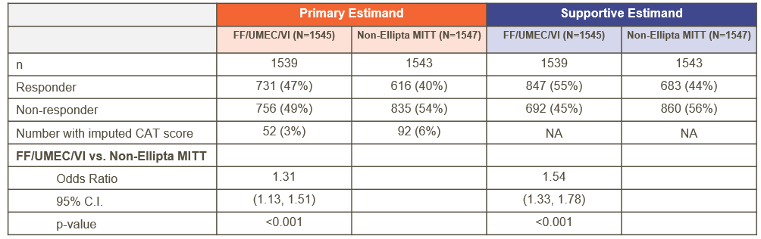
Estimand example: INTREPID STUDY
Primary Effectiveness Endpoint (ITT Population)
The amount of missing data can have a big impact on the results, prevention is critical.
The choice of missing data approach can have a large impact on the treatment effect reported. In this analysis, the NRI went in our favour, however it could have equally counted against us.
Are the competitors presenting their Primary estimand or are they presenting the most favourable?
FoS: Medical Affairs training

Slide 19
Types of Missing Data
Missing Completely at Random​ (MCAR)​ | Missing at Random​ (MAR)​ ​ | Missing Not at Random​ (MNAR)​
Dog eats the students homework at random​ | Dog eats the students homework closest to him​ | Dog eats the students homework with the highest grade​
Missingness is not dependent on the value that is missing ​ nor on other data collected​ | Missingness is not dependent on the value that is missing, ​ but is dependent on other data collected​ ​ | Missingness is dependent on the value that is missing​
Missing Completely at Random​ (MCAR)​
Dog eats the students homework at random​
Missingness is not dependent on the value that is missing ​ nor on other data collected​ ​
Missing Completely at Random​ (MCAR)​ | Missing at Random​ (MAR)​ ​
Dog eats the students homework at random​ | Dog eats the students homework closest to him​
Missingness is not dependent on the value that is missing ​ nor on other data collected​ | Missingness is not dependent on the value that is missing, ​ but is dependent on other data collected​ ​
FoS: Medical Affairs training

Slide 20
Knowledge Check
Why is missing data an issue in Clinical studies?
  It’s not, we are only interested in what happens whilst a subject is on treatment so we can ignore what happens when they stop taking treatment
  It may be missing for a reason associated with the subject
  It may be missing for a reason associated with the treatment or intervention
  b & c
FoS: Medical Affairs training

Slide 21
Knowledge Check
Which of these causes of missing data is least likely to introduce bias?
  A subject moves house and can no longer attend the clinic
  A subject dies
  A subject withdraws due to lack of efficacy
  A subject withdraws due to an adverse event
FoS: Medical Affairs training

Slide 22
Key Messages
Missing Data
What do you need to do?
Missing data can introduce bias.
Be aware of discontinuation rates in studies, and whether they are balanced across treatment groups.
Prevention is the first step to cure - plan trials in such a way to minimise missing data.
If results are “borderline” statistically significant (i.e. p-value is close to 0.05), consider how missing data has been handled and whether sensitivity analyses have been performed.
If in doubt: Talk to your Statistician!
Missing data is a reality of clinical research. We need to be aware of it and its potential to bias our inferences.
Be clear about how it should be handled and understand the implications of this.
Consider what assumptions would be reasonable for subjects who stop taking treatment. Be involved in this discussion in protocol development.
FoS: Medical Affairs training

